Slide 1
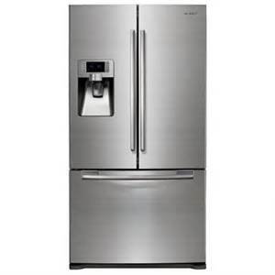
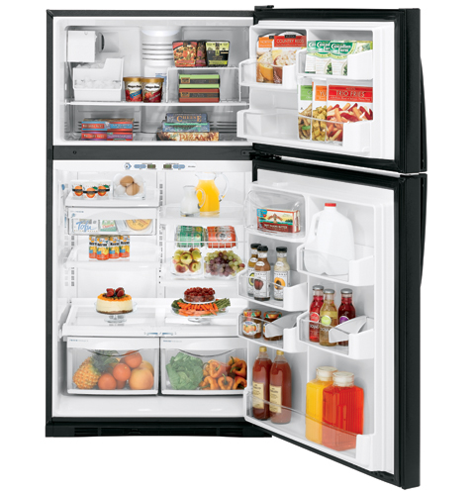
How Refrigerators and Freezers Work
A refrigerator is also called a “fridge”
A refrigerator is a machine that can make its inside colder

Slide 2
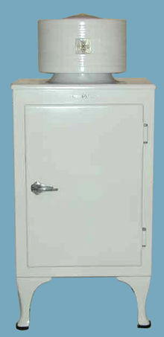
A short history of refrigerators
Before the refrigerator was invented, some people would use ice from frozen lakes to keep food cool, but it was difficult and expensive to move so much ice
The first refrigerator used by many people was the "Monitor-Top" refrigerator starting in 1927
Home freezers started being used in the U.S. in 1940
A Monitor-Top refrigerator

Slide 3
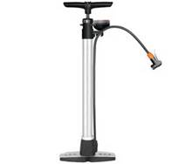
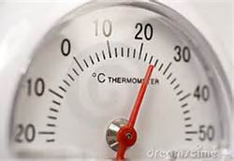
How it works: Step 1
When the temperature inside the refrigerator is above a certain set temperature, the thermostat turns on a compressor
A thermostat is a thermometer that can turn something on
A compressor is a machine that can squeeze a gas, which makes it have a smaller volume
The compressor is what you hear humming
A compressor is like an electricity-powered bicycle pump
A thermostat may look like this

Slide 4
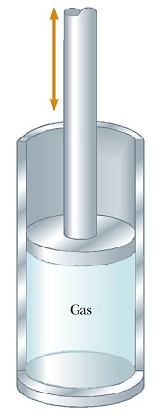
Step 1 continued
The compressor then squeezes the refrigerant, which is a fluid used for cooling. The refrigerant is a gas at this time
This squeezing of the refrigerant causes it to increase in pressure and temperature
Remember: P₁ P₂
T₁ T₂
If pressure goes up, temperature goes up
=
This shows how a gas can be compressed (squeezed)

Slide 5
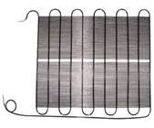
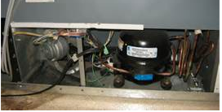
Step 2
The very warm refrigerant goes through a coil outside (usually behind) the refrigerator where it loses heat to the air outside
A coil is a long, snake-like tube
This outside coil is called the “condenser coil” because as it cools, the refrigerant changes from a gas to a liquid (condenses) and gives off heat
Left: compressor
Right: condenser coils

Slide 6
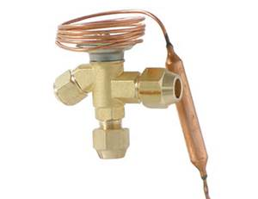
Step 3
After the refrigerant has cooled down from giving heat to the air outside the fridge, the “expansion valve” opens to let the liquid refrigerant pass through it, into the coils inside the refrigerator
A “valve” is a small hole that can be opened or closed, and “expansion” means getting bigger, so what does “expansion valve” mean?
This is an expansion valve

Slide 7
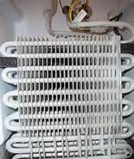
Step 4
The pressure on the other side of the expansion valve in the evaporator coils is low
The pressure is low because the compressor has pulled the refrigerant out of that side in step 1
This low pressure makes the refrigerant change from a liquid to a gas (evaporate) and take in heat
Remember: P₁ P₂
T₁ T₂
If pressure goes down, temperature goes down
=
Evaporator coils inside a freezer

Slide 8
Step 4 continued
The refrigerant expands (gets bigger) as it goes through the expansion valve
It also decreases in pressure and temperature
The refrigerant absorbs (takes in) heat from inside the refrigerator because it as a lower temperature
The refrigerant is now ready for step 1 again!
Remember: P₁ P₂
T₁ T₂
If pressure goes down, temperature goes down
=

Slide 9
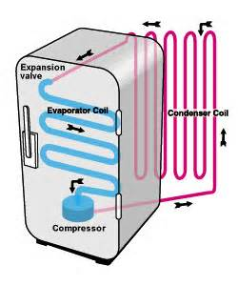
Summary of the 4 steps
Step 3: The refrigerant liquid goes through the expansion valve and turns back into a gas. Pressure ↓, Temp.↓
Step 2: The refrigerant goes through the condenser coils. It gives off heat to the surrounding air and condenses to a liquid
Step 4: The refrigerant goes through the evaporator coil and absorbs (takes in) heat from inside the refrigerator
Step 1: The compressor squeezes the refrigerant gas. Pressure. ↑, Temp.↑,

