Slide 1
COMPUTER HARDWARE

Slide 2
Definition of Computer hardware
It is any physical part of the Computer that you can touch or see.
These also include devices that are physically connected to a Computer. (Computer peripheral)

Slide 3
Hardware devices
Input devices
Out put devices.
Storage devices (primary)& (Secondary)
Processing devices (ALU &CU).
Communication devices.

Slide 4
Input devices.
These are devices used in entering data. Input could be text, numbers, letters, images, sound among others.

Slide 5
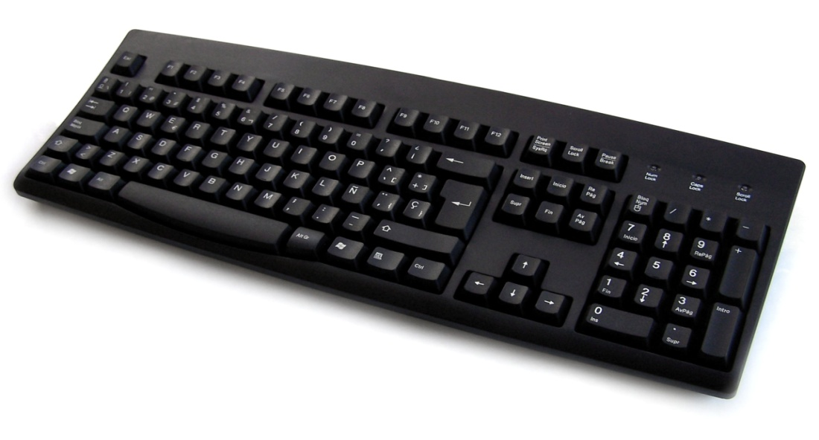
Types of Input devices.
Keyboard A plastic board with a number of buttons on it known as keys.
Entering of information on into a Computer is done by pressing these keys

Slide 6
Section of the keyboard.
Qwerty pad This is the main section on the keyboard where letters are.
Number pad The far right side of the keyboard features a number pad that resembles a calculator.
Arrow keys The right button of a keyboard features four directional arrow keys. These keys provide navigation through word processor documents.

Slide 7
Sections of the keyboard
F Bar The top of a keyboard features the F keys a selection of keys that extend to F12.
Extra keys These are shortcuts of commands on the keyboard like sleep mode, calculator, my computer common on most keyboards.

Slide 8
Merits of using the keyboard.
No need to buy additional equipment since pcs are normally supplied with keyboard
Entering data and instructions with keyboard is generally faster.
Keyboards are more reliable and produce fewer errors.

Slide 9
Demerits of keyboard.
It takes a lot of time to practice in order to quickly and accurately type.
Typing speed is still slow when compared to computer speeds.

Slide 10
Types of Keyboards
Traditional key board. This is a full sized keyboard.
Flexible keyboard. This is a portable type of keyboard that can be folded.
Keypad. This is a miniature keyboard used on portable devices such as PDAs laptops.
Braille keyboard. This is a keyboard for the blind.

Slide 11
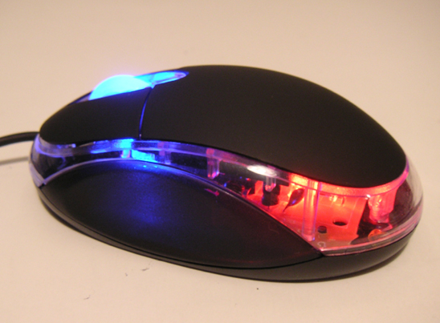
INPUT DEVICES
Mouse. This is a pointing device with two or more buttons on it. It has a pointer that moves on the screen when the mouse is moved.

Slide 12
Types of Mouse.
Mechanical mouse . This has a ball underneath, two buttons and an optional scroll wheel.
Optical mouse. This uses light emitting diode (LED) an optical sensor and digital signals processing.
Cordless Mouse. Battered powered mouse that use radio or infrared waves.
Track ball mouse. This mouse has a ball located at the top.

Slide 13
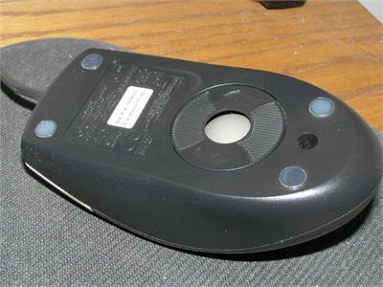

Pictorial of mice.

Slide 14
Input devices cont
Microphone. This helps to input voice/ sound.
Light pen. It is shaped like a pen . It allows users to select items, icons with direct contact with the monitor.
Webcam. This provides visual data to the computer in the form of images and video.
Digital camera. This takes pictures and stores a digital photographic image that can be read
Joy stick. This is a specialized pointing devices used for playing games.
Stylus . This a touch sensitive device such as PDAs screen.

Slide 15
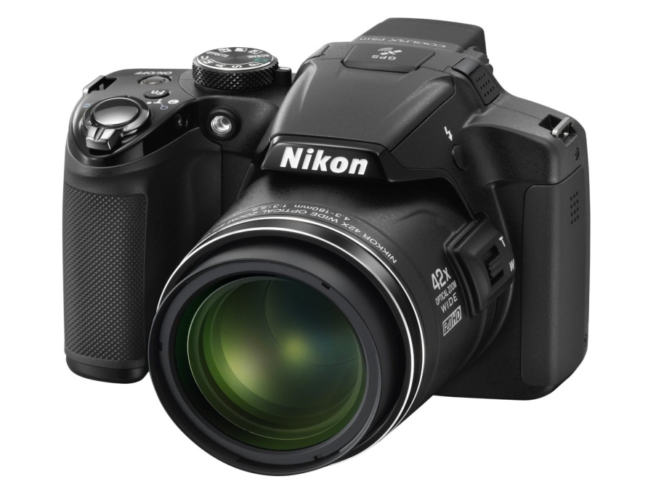
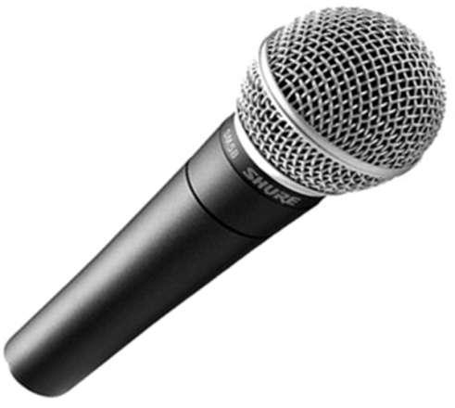
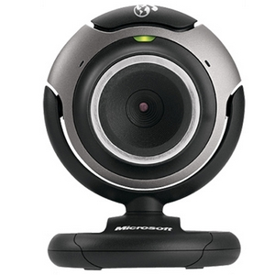
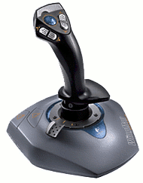
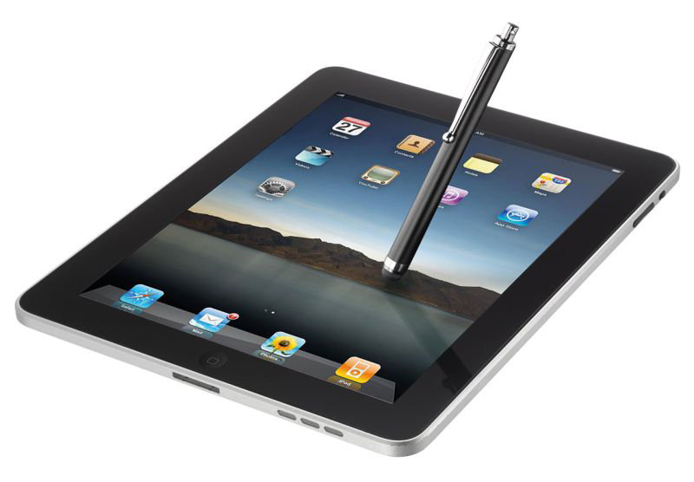
Pictorial of input

Slide 16
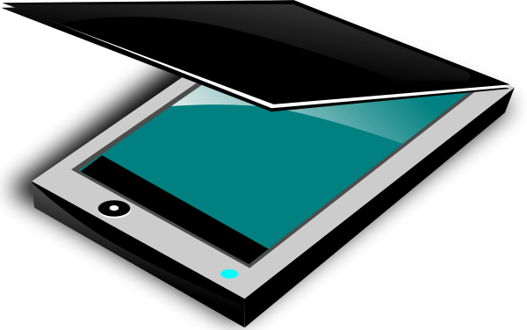
Input cont
Scanner. This a device that is used for quick input of text or images. Scanners are capable of converting pictures or graphics from paper to digital format.

Slide 17
Types of Scanners
Flat bed scanner. It works like a copy machine except it creates a file of the document.
Sheet feed. It has a motorized rollers that can feed the source document across the scanning head during the scanning process.
Hand held . Can be manually pressed over the image to be scanned.

Slide 18
Others types of scanners
Magnetic Ink character Reader(MICR) This is used in banks for scanning cheque numbers.
Intelligent Character Recognition (ICR). This is an advanced scanning system that can translate a wide variety of printed fonts and type styles including the recognition of handwritten text from paper sources into electronic text.
Optical Character recognition (OCR). This is a scanner used to read typewritten, computer and transforms the images into a softcopy that can be manipulated using a word processor.
Optical mark recognition (OMR). This detects marks made on a piece of paper using ink or a soft pencil using infrared beam.

Slide 19
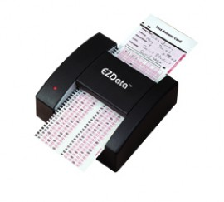
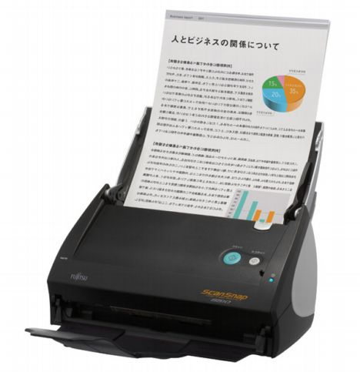
Scanner Pictorial

Slide 20
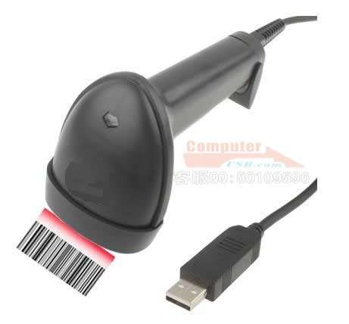
Scanners continued
Optical bar recognition (OBR). These are scanners used to capture data coded as lines of varying thickness known as barcodes.
Barcode Readers. Used in Supermarkets to read coded price tags on the items.
Two common types of barcode scanners are hand held wand and desktop bar code.

Slide 21
Other Input.
Magnetic Card reader. This is used to read data covered on a magnetic strip on a plastic card such as the one used on an automated teller machine.
Touch Screen. These are special types of VDUs that enable the user to interact with the computer by simply touching the screen.
Digitizer. A Graphic tablet. This is made up of a flat surface and allows the user to draw an image using a stylus.
Sensors. These are devices that are used to detect and supply either physical or environmental information.

Slide 22
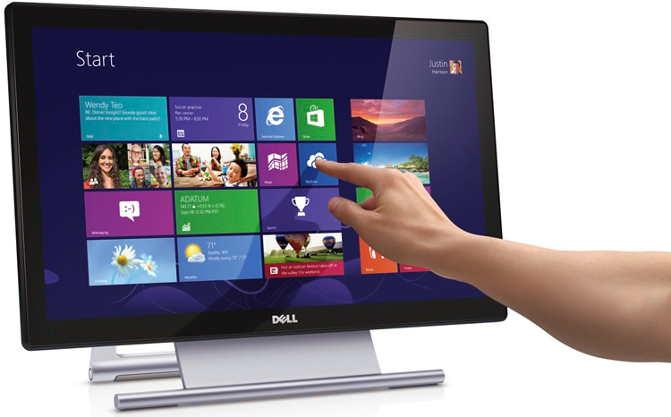
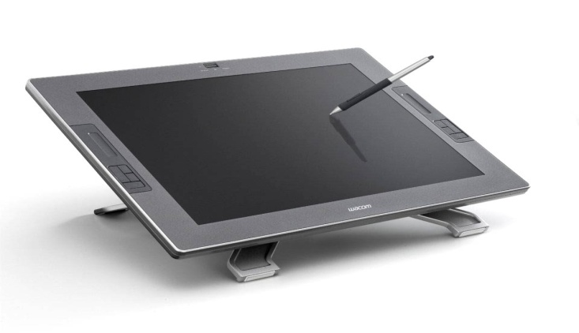
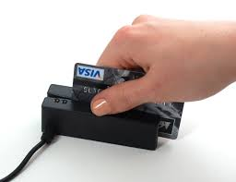
Pictorials of other input devices

Slide 23
OUTPUT DEVICES
Output devices make it possible for the user to get processed information from the computer.

Slide 24
Classification of output.
Softcopy output devices. Monitors (CRT&LCD) Projector.
Sound Output. Speakers, Headphones.
Hardcopy output devices. Printers.
Communication devices. Modem.

Slide 25
Output devices continued
Monitor. Known as Visual display unit (VDU) . It is used to display information in the form of text, pictures and video.
Three common types of monitors include:
Cathode Ray tube (CRT), Liquid Crystal display (LCD).
Gas plasma display monitor.

Slide 26
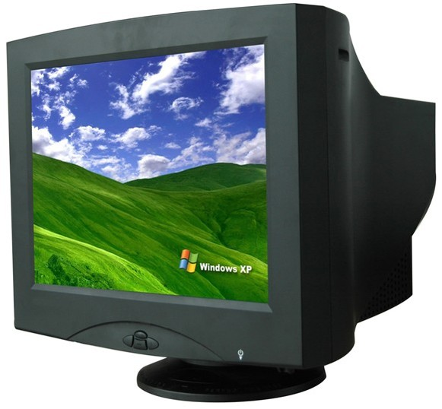
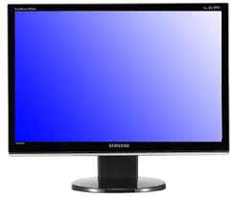
Types of Monitors

Slide 27
Output continued
Projector. This is used to display output from a computer on plain white screen like a wall or whiteboard.
Speaker. These are devices that gives sound output from the computer.
Printers. These are used to print text of the monitor onto paper.

Slide 28
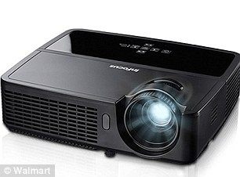
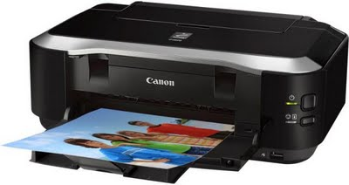
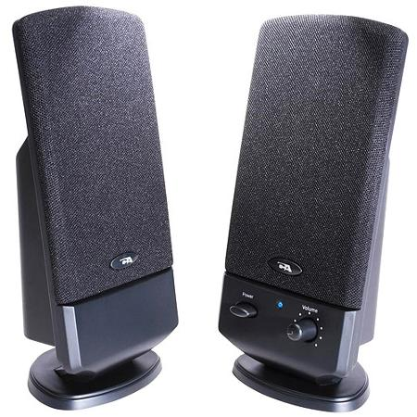
Pictorial of Projector, Speaker, Printer

Slide 29
Classification of Printers.
Impact Printer. This uses striking mechanism. All printers that work by striking an ink ribbon.
Non Impact Printers. These produce a hardcopy without the print head physically touching the printing media.

Slide 30
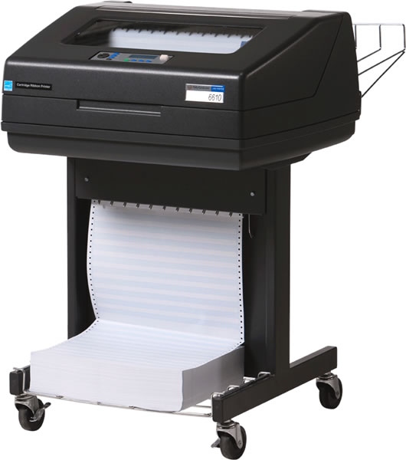
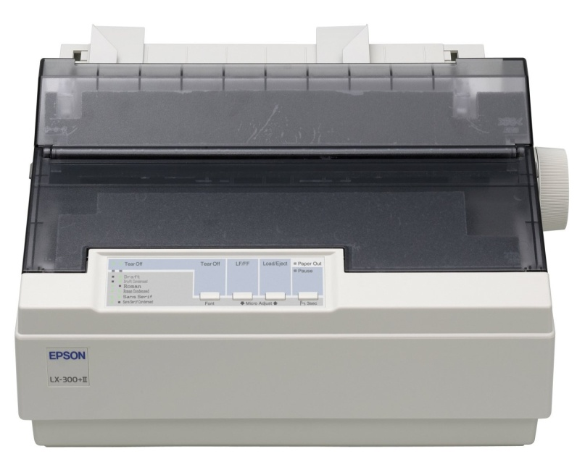
Examples of impact printers
Dot matrix printers. These use dots to print.
Line Printer. These print an entire line at one time per machine cycle by forcing the typed character against a ribbon.

Slide 31
Merits of Impact Printers
Impact printers are cheaper to run.
They are widely used in commercial printing.
They are reliable.
They are easier to maintain.
They have a lower print resolution as compared to other types of Printers.

Slide 32
Demerits of impact printers.
These Printers are very noisy during operations.
They overheat especially during long print outs.
They provide low quality printouts.
Less sensitive to environmental conditions.

Slide 33
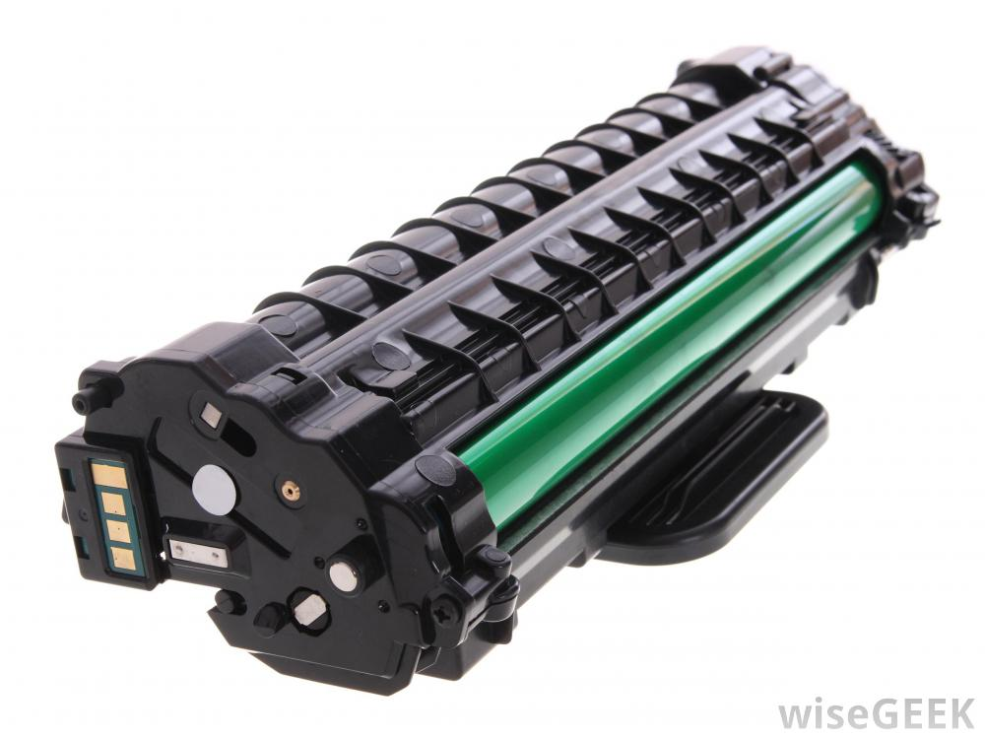
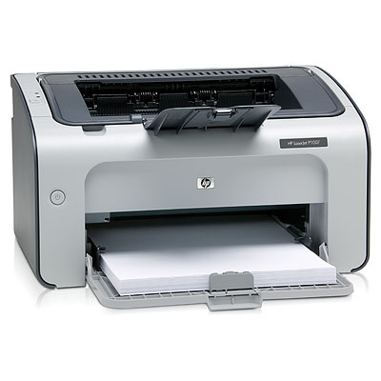
Examples of Non-Impact Printers
Laser Printer. This operates by shinning a laser beam to create an image on a rotating drum . As the beam hits the drum it ionizes some regions which attract ink toner particles. The toner is then fused onto a piece of paper.

Slide 34
Merits of Laser Printer.
They produce a very high quality out put.
Are very quiet and very fast.
They are cable of producing colour printouts.
Their maintenance costs is low as tonner takes long to get finished.

Slide 35
Demerits of Laser printer.
They are expensive to acquire .
Cost of printing per page is higher.
Typical printers do not print in colour.

Slide 36
Non-Impact printers cont
Inkjet Printers.
These use ink cartridges in printing. These print by spraying tiny droplets onto a paper to create an image.

Slide 37
Merits of inkjet printers
Colour inkjet printers are cheaper to buy than laser printers.
Inkjet printers are generally quiet and not noisy like the Dot matrix.
Can produce high quality colour out put.
They are cheap as compared to the laser printers.

Slide 38
Demerits of inkjet printers.
They have a low printing speed compared to laser printers.
They also require specialized paper to produce high quality colour out put.
They are expensive to maintain.

Slide 39
Non-impact printers cont
Photo printers. These are special printers designed to print photographs.
Thermal printer. This works by heating solid ink which is normally in wax.
Plotter. This is used to print wide format print outs mainly photographs, maps and architectural designs.

Slide 40
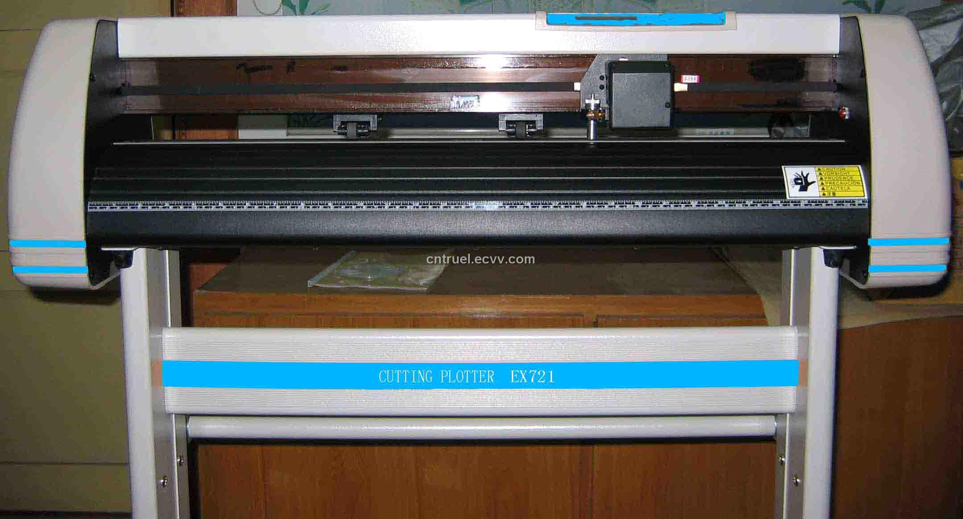
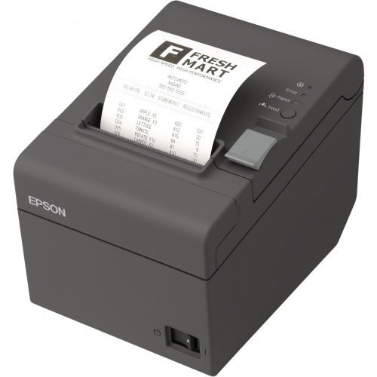
Pictorial of Printers

Slide 41
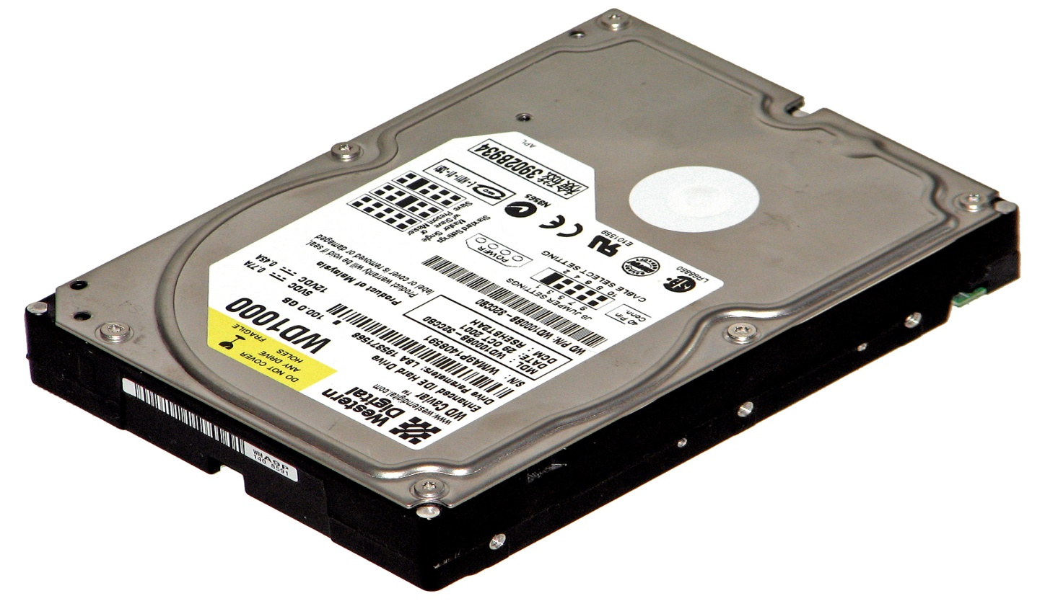
Storage devices.
These are devices that hold information.
There are two types of storage devices that is primary and secondary storage devices.

Slide 42
Primary storage devices.
This is part of the computer’s memory that hold data temporally. These are Random Access memory (RAM) and Read only memory (ROM).
Ram is used to store information temporally
Rom is used to store data permanently.

Slide 43
Types of Ram chips
Static Ram (SRAM)
Dynamic Ram (DRAM)
Cache memory is a place that stores something temporally .
A buffer is a region of memory that is used to temporally hold data while it is being moved fro place to place.
CMOS- Complimentary metal oxide semiconductor-memory used to store configuration information.

Slide 44
Types of Rom
PROM Programmable Read Only memory
EPROM – Electrically Programmable Read Only Memory.
EEPROM- Electrically Erasable Programmable Read Only Memory.

Slide 45
Comparison between Ram &Rom
RAM
ROM
Is Volatile
Is read and write
Is temporal
Can be increased
Non Volatile
Is read only
Is permanent
Is not normally increasable

Slide 46
Secondary/ Auxiliary storage devices
Storage devices designed to retain data and instructions in a relatively permanent form.
Types of secondary devices.
Magnetic storage devices.
Optical storage devices.
Solid state storage devices.

Slide 47
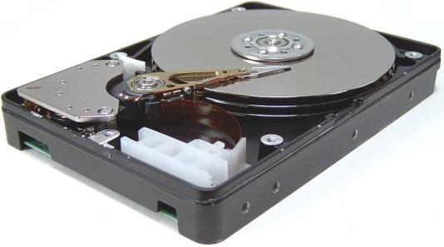

Magnetic storage devices
. This is a device that uses a magnetic head to write data to and from a magnetized medium.

Slide 48
Types of Magnetic storage
Hard disk- This is a permanently fitted storage device in the computer.
Floppy disk – A thin, circular, flexible plastic disk with a magnetic coating in a square shaped plastic shell.
Magnetic Tape- Magnetically coated ribbon of plastic capable of storing large amounts data and information.

Slide 49

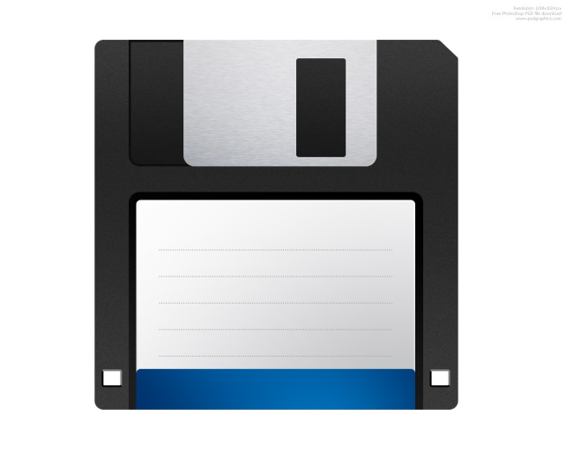
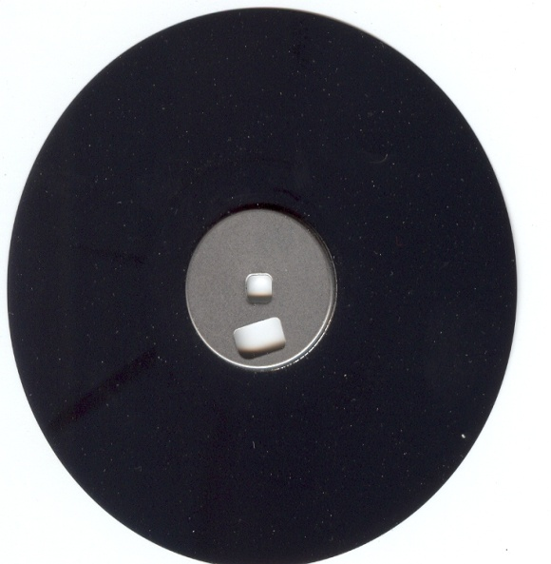
Pictorial of magnetic storage

Slide 50
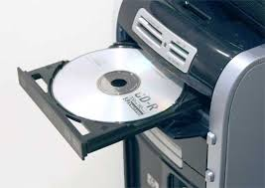
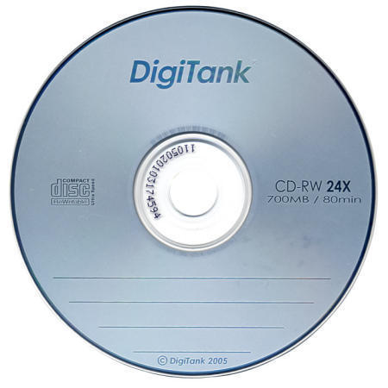
Optical storage devices.
These are electro-mechanical units coated with highly reflective material. The data is written to a surface of a disk spinning by focusing a high power laser beam.

Slide 51
Types of Optical storage devices
CD-R – Compact Disk Read Only Memory
CD-RW- Compact Disk Re-writable.
DVD-R- Digital Video Disk- Read Only Memory
DVD-RW- Digital Video Disk-Re-Writable.
Photo CD- this contains digital photographic images saved in the photo CD format.
Blue-ray disk- This stores information of high definition. (HD)

Slide 52
Solid state storage
These are devices that are made of a silicon microchip. These devices store data electrically.
Forms of Solid state.
Solid state drives (SSD) like Flash memory disk
Solid state cards (SSC) memory cards, smart cards.
Solid state modules (SSM) resides in dual in line memory in mobile phones, which include microfilms, microfiches used in microscopic images.

Slide 53
Characteristic of storage devices
Storage capacity- the amount of data that a storage device /medium can hold.
Transfer rate- Time required to transfer data or read from the disk into main memory.
Access time- Amount of data a devices takes to locate an item on a medium and make it available to the computer.

Slide 54
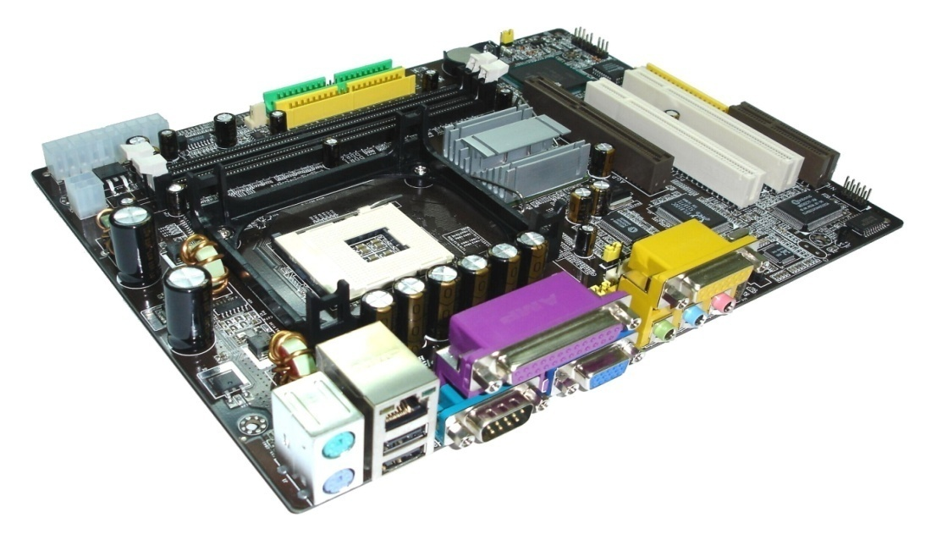
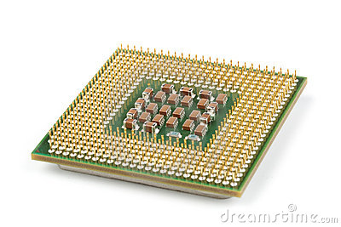
Processor components
These are computer devices that work together in gathering , decoding and outputting of information to the computer user.

Slide 55
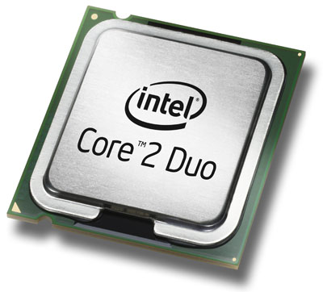
Central Processing unit.
This is responsible for document processing in the computer system . It is considered as the brain of the computer.

Slide 56
Parts of the CPU
Control Unit- It controls and coordinates all the operations within the CPU. It retrieves the instructions from memory, translates and interprets the instructions into computer functions and sends instructions to other computer hardware for execution.

Slide 57
Parts of the CPU Cont
Arithmetic and Logical Unit (ALU)- This performs the arithmetic, comparison and logical operations.
Registers (Memory)- This is a circuitry which acts as the main store, internal store. It is used to store data within the CPU while the computer is processing functions.

Slide 58
Common Types of Registers
Accumulator- Holds the initial data to be operated upon and the results of arithmetic and logical operations.
Instruction register- This temporarily stores the instruction supplied.
Instruction decoder- Interprets or decodes the current instructions held by the instruction register.

Slide 59
Types of registers Cont
Program counter- Holds the address of the next instruction to be fetched from memory.
Status flag- Holds a collection of conditions flags which describe the status of the most recent operations carried by the ALU.
Memory Address Register- Holds the address of the location when an instruction is read or written in the memory.

Slide 60
Types of Processors
Intel- Pentium I, II,III,IV, Dual Core
AMD- Sempron, Athlon, Duron, Turion, Opteron.
Celeron M, Pentium M, Core Mobile.
Latest Processors- Inter Pentium Dual Core Processor, Inter Dual Core i3 Processor, i5 processor, i7 processor.

