Slide 1
DATA COMMUNICATION AND NETWORKING

Slide 2
Meaning of Data Communication
This refers to the electronic transmission of information that has been encoded digitally (as for storage and processing by computers) from source to destination.
It is the high speed data exchange between computers and other electronic devices via cable or wireless.

Slide 3
Elements of Data Communication
Sender.
Receiver.
Messages.
Transmission medium.
Protocol.
Communication device/ modem.

Slide 4
Elements explained
Sender. Devices that initiate an instruction to transmit data and instruction e.g source computer.
Receiver. Device that accepts the data signals from the source device.
Messages. Data/ information to be transmitted over a transmission medium.

Slide 5
Elements Continued
Transmission medium. This is a communication channel over which the data signals are sent e.g physical (cables) or wireless (infrared, radio, micro) waves.
Protocol. Set of rules and procedures for exchanging information among computer devices on a network. Protocol defines how the information is transmitted and how errors are detected and corrected.
Communication device. Device that converts the data from the sending devices into signals that can be carried by a transmission medium to receiver.

Slide 6
Data Communication Tools
These are tools that enable you to emulate and test networks.

Slide 7
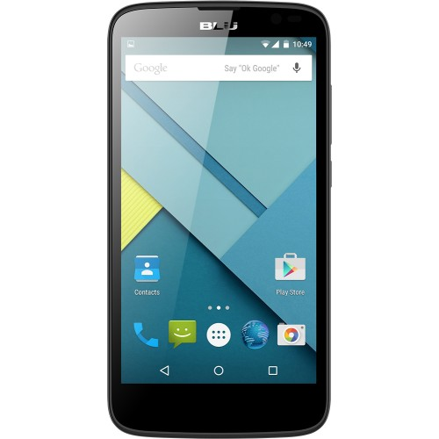
Types of data communication tools
Phones.
Email.
Social Networks.
Instant Messaging .

Slide 8
Data tools explained
Phones. Wireless phones are a dominant form of communication. Text messaging is rampant and the advent of the smart phone has enabled mobile phones to have PC functionality.
Email. Function of the internet and users can access it from myriad devices such as cell phones.

Slide 9
Data tools explained cont
Social Networks. These enable instant interaction among users who can communicate directly. Such as Twitter.
Instant Messaging and Skype. This instant messaging is done most often on keyboard over the internet while Skype offers online calling, messaging and video calling all across the world via the internet.

Slide 10
Comparison btn Electronic and Manual data Communication tools
Manual
Electronic
Does not require subscription.
Cheap to maintain.
Single communication tool such as drum.
Drums are world’s oldest .
Bells were associated.
Messages carried by couriers include postal services, office massagers.
Requires Subscription
Costly to maintain as servicing.
Lightening fast mode.
With aid Video, sound, mobile phones have increased communication.
Mobile phones as communicative tools.
Portal communication
Email communication.
Email messages.

Slide 11
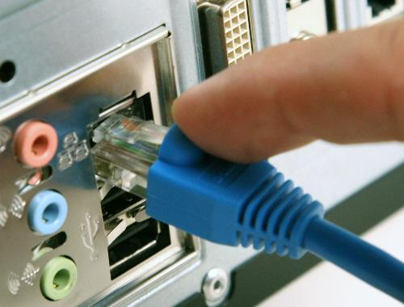
Data Transmission media
Communication channel or path over which the data signals are sent from the source to the destination.

Slide 12
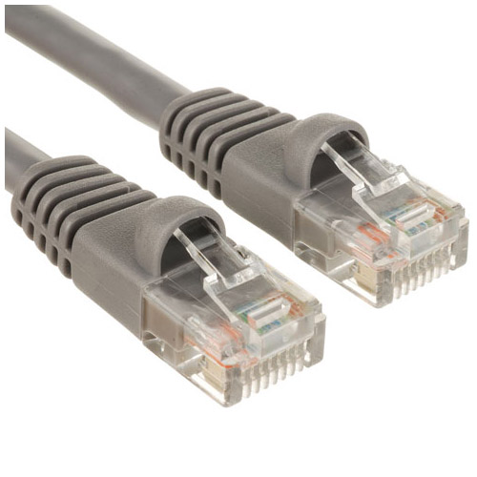
Types of transmission media.
Physical (Guided) transmission media.
Wireless (unguided) transmission media.

Slide 13
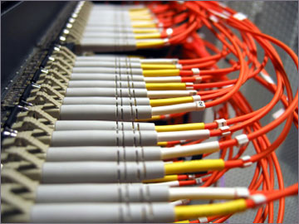
Data Transmission media explained
Guided Transmission media.
This provides a physical path usually along which the signals are propagated.
Theses include twisted pair cables, coaxial cable and optical fiber cables.

Slide 14
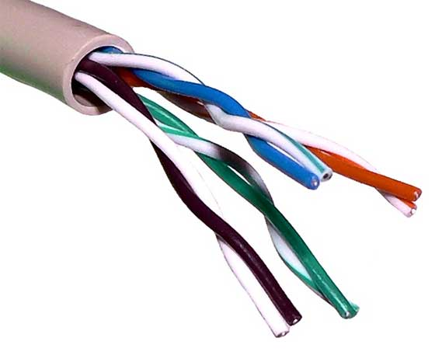
Data Transmission cont
Twisted pair cables.
This pair consists of a pair of insulated copper wires arranged in a regular spiral pattern.

Slide 15
Categories of Twisted pair cables.
Unshielded twisted pair (UTP).
Shielded twisted pair (STP).

Slide 16
Categories continued
Unshielded twisted pair (UTP) do not have a shield against Electromagnetic interference or electronic interference from the environment.

Slide 17
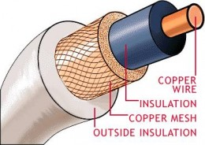
Categories cont
Coaxial cables.
High capacity cable having a single copper conductor at its centre. It has a plastic layer that provides insulation between the mental shielding and the conductor.

Slide 18
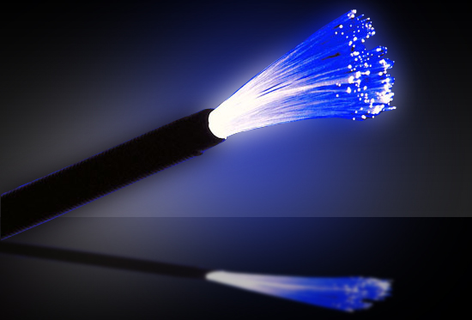
Categories cont
Optical Fiber cables.
Type of cable having a glass core at its centre and is surrounded by several layers of protective material.

Slide 19
Use of Optical cables
Long-haul trunks. 1500 km
Metropolitan trunks 12km
Rural exchange trunks. 40 to 160km
Subscriber loops. (link telephone network)
Local Area Network.

Slide 20
Merits of Optical fiber cables
Greater capacity.
Small size and lighter weight.
Lower attenuation.
Electromagnetic isolation.
Greater repeater spacing.

Slide 21
Demerits of Optical fiber cables
Installation of cables is difficult because of its delicate nature.
Very expensive to manage the connectivity devices.
Very complex to configure.

Slide 22
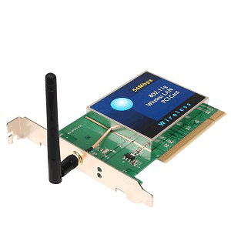
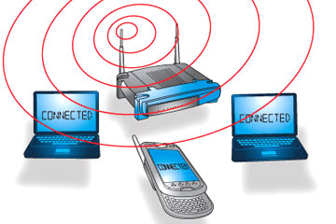
Wireless (unguided)
A type of transmission media that is used to transmit data signals from one point to another without physical connections.
This is done by use of antennas and receiver aerials.

Slide 23
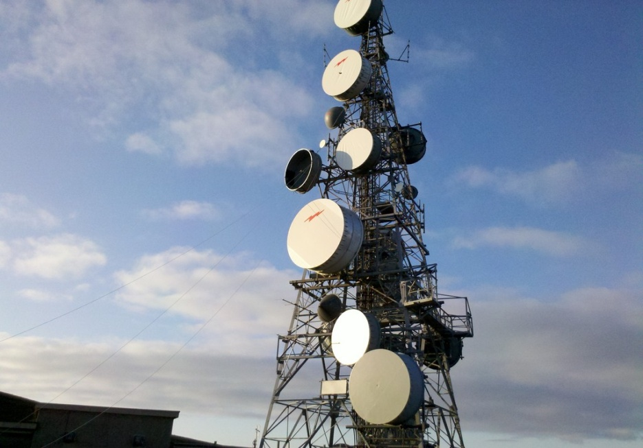
Categories of wireless transmission
Satellite (broadcasting transmission)
This is a microwave relay station used to link two or more ground based microwave transmitter/ receivers, known as earth Stations or ground stations.

Slide 24
Application of satellite communication
Television distribution.
Long distance telephone transmission..
Private business network.
Radio
Internet access
Military.
Blue Tooth
Wi-Fi (Wireless Fidelity)

Slide 25
SERVICES OFFERED BY DATA COMMUNICATION TOOLS.
Email.
Skype.
Instant messaging (IM).
News group.

Slide 26
Services offered by data communication tools explained.
Email: Method of exchanging of digital messages from an author to one or more receipts across the internet.
Skype: method of communication with peers by voice over the internet.
Instant Messaging (IM): Method of communication over the internet that offers quick transmission of text-message from sender to receiver.

Slide 27
Services offered continued.
Instant messaging (IM): Is a form of communication over the internet, that offers quick transmission of text-based messages from sender to receiver.
News groups. Forums usually within the Usenet system for messages posted from many users in different locations.

Slide 28
Implications of Data communication services.
Faster Communication with partners.
Improved Standards in hardware and software products.
New ways of doing business emerge due to networking.
Integration of voice, video and data onto the same network simplifies networks and enable easy access

Slide 29
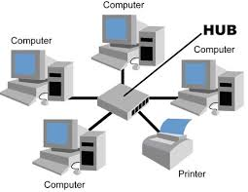
Computer Networks
A computer network is a collection of computers and other hardware linked together using transmission media for purpose of resource sharing.

Slide 30
Purpose of Computer Networking
Enable resource sharing like printers, modems, storage medium, application programs.
Enable remote communication between devices. People can communicate via email.
To enable cost effectiveness and reliability in organization.

Slide 31
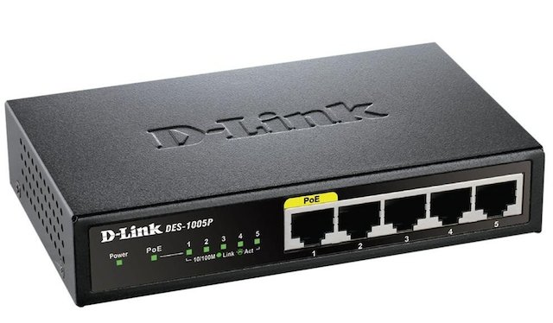
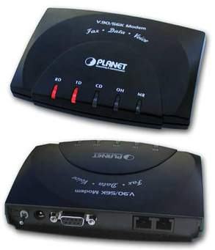
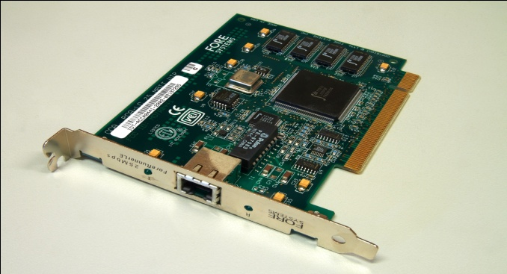
Requirements for Computer Networks.
Computers /Clients.
Hub/switch.
Network interface card.
Server.
Transmission media.
Modems.
Network software.

Slide 32
Requirements explained for network setup.
Computers. computers on the network that send requests to the server and also receive response from the server. (workstations)
Hub/Switch. This gets input signals in one port and sends the output to many of its other ports. Hence it connects many systems to the server.

Slide 33
Continued requirements
Network Interface card. Is a piece of Computer hardware designed to allow computers to physically access a network medium.
Server. Computer running software that enables it to serve specific requests from other computers (clients)
Modem. This connects multiple computers to a single DSL line for internet acess.

Slide 34
Requirements Cont
Network Software. Software designed to help set up, manage and monitor Computer networks.
Examples include: Mozilla Firefox, Opera etc.

Slide 35
Implication of Computer networks
Cost Reeducation. Business costs of storing information in one location.
LAN allows employees at a central location to access company data and send this information to others in the company.
Opportunities. For business, pleasure, career development all can be got through computer networks.

Slide 36
Implications Cont
Computer networks have opened gates of information and enable instant access to information.
Networks have ushered in a digital society affecting everyday life, identity, culture etc.
Networks have brought in globalization of production by reducing cost of information and communication.
Computer networks have created vast resources for people to enhance their learning.

Slide 37
Implications cont
Advertising is huge revenue source for many companies. Such as banking, airline booking, movie rentals.
Wireless services are now possible such as the Global positioning systems (GPS) combined with wireless Internet access help users to locate alternative routes, improve traffic management and congestion control.

Slide 38
Implications Cont
Internet is offering the possibility of creating an environment where individuals socially interact, work together online whatever the distance.

Slide 39
Negative implications of networks
Viruses. Computer viruses can easily spread over the network.
Downtime. Failure of one computer may not affect others however if it is the server, switch, routers going down the entire network will do down.
Cost and complications. Home networks are expensive and additional equipments needed may be complicated to the user.
Harmful content. Internet is full of content that might be harmful say misleading advertisement.

Slide 40
Types of Computer Networks.
Local Area Network. (LAN) Used to interconnect many computers within a given local area say premises of a single organization building such as a school.
Metropolitan Area Network. (MAN) Interconnection within geographical limits of a city or town. Say a company that has many branches across an area.
Wide Area Network. Used to interconnect a number of widely dispersed computers in various cities of a country. WANS use communication media maintained by telegraph or telephone companies which usually have landlines, underground coaxial cables, microwave communication and satellite communication.

Slide 41
Computer Network Models
Peer to Peer network. In a peer to peer network each computer acts as both the client (information requestor) and serve(information provider).

Slide 42
Merits of Peer to Peer network.
It is the easiest type of network to build.
There is no need for a central server.
Network is cheap to setup and maintain.
Each Pc can make backup copies of its data to other Pc for security purposes.

Slide 43
Demerits of Peer to Peer networks.
There is no central repository for files and applications that is files and applications are not decentralized.
It does not provide the security available on a client/server network..
Network becomes slow for a network of more than 10-15 computers.

Slide 44
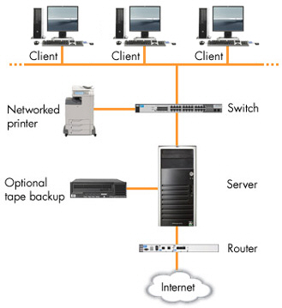
Client-Server Networks.
Files are stored on a centralized, high speed file server PC that is available to client PCs. All networking services such as printing, and internet are routed through a server.

Slide 45
Merits of Client-Server networks
Centralization: Resources and data security are contained through the server.
Scalability. All elements can be replaced individually as need arises.
Flexibility. New technology can easily be integrated into system.
Interoperability. All components work together.

Slide 46
Demerits of Client-Server networks
Expense. Requires high initial investment in a dedicated server.
Maintainace. Large networks will require a staff to ensure efficient operation.
Dependence. When server goes down, operations will cease across the network.

